Slide 1
EXPLORATORY DATA ANALYSIS
New York City
Airbnb Listings
What drives the price of a bed for the night?
48,895
5
221
16
listings
boroughs
neighbourhoods
columns
Khalid Al Dosari · Tuwaiq Bootcamp
Notes:
New York City Airbnb. 48,895 listings across all five boroughs from 2019. My question was simple. What actually sets the price of a listing? The first half covers the data quality problems I had to fix before I could trust anything. The second half covers what the cleaned data showed.

Slide 2
The data
One row is one listing
48,895
16
20.3%
8 Jul 2019
rows
columns
never reviewed
last review
Numerical
Categorical
price · minimum_nights · availability_365
number_of_reviews · reviews_per_month
calculated_host_listings_count
id and host_id are labels not measurements
neighbourhood_group: 5 boroughs
neighbourhood: 221 values and imbalanced
room_type: 3 values
host_name: free text
No target variable. Price if modelled.
Not categorical: name and last_review
Notes:
Each row is one listing. It carries the host and the location and the price and the review history. Ten numeric columns. Two of them are identifiers rather than measurements. There is no target variable here. This is an unlabelled market snapshot. Price is what you would predict if you modelled it. One flag up front. A fifth of listings have never been reviewed.

Slide 3
Six problems and six fixes
The decision matters more than the method
PROBLEM
WHAT I FOUND
FIX
1
Missing values
9,901 with no reviews. 20.3%
reviews_per_month → 0
2
Hidden duplicates
duplicated said 0. Really 217
keep the most recent
3
Wrong data type
last_review stored as text
convert to datetime
4
Invalid values
11 listings priced at $0
group median by location
5
Inconsistent categories
11,453 host names → 11,429
lowercase and strip
6
Outliers
1,250-night minimums
cap at 365 and keep the rest
Notes:
Six problems and six decisions. Two are worth pausing on. Number two. Pandas said zero duplicates. That only means no two rows are identical across all sixteen columns. Define a duplicate the way the business would. Same host at the same coordinates at the same price. Then 217 appear. Number six. Those 1,250 night minimums are not errors. The listing names say things like not available. Hosts are faking a pause button. So I capped rather than deleted. The value is a signal about host behaviour and not dirt.

Slide 4
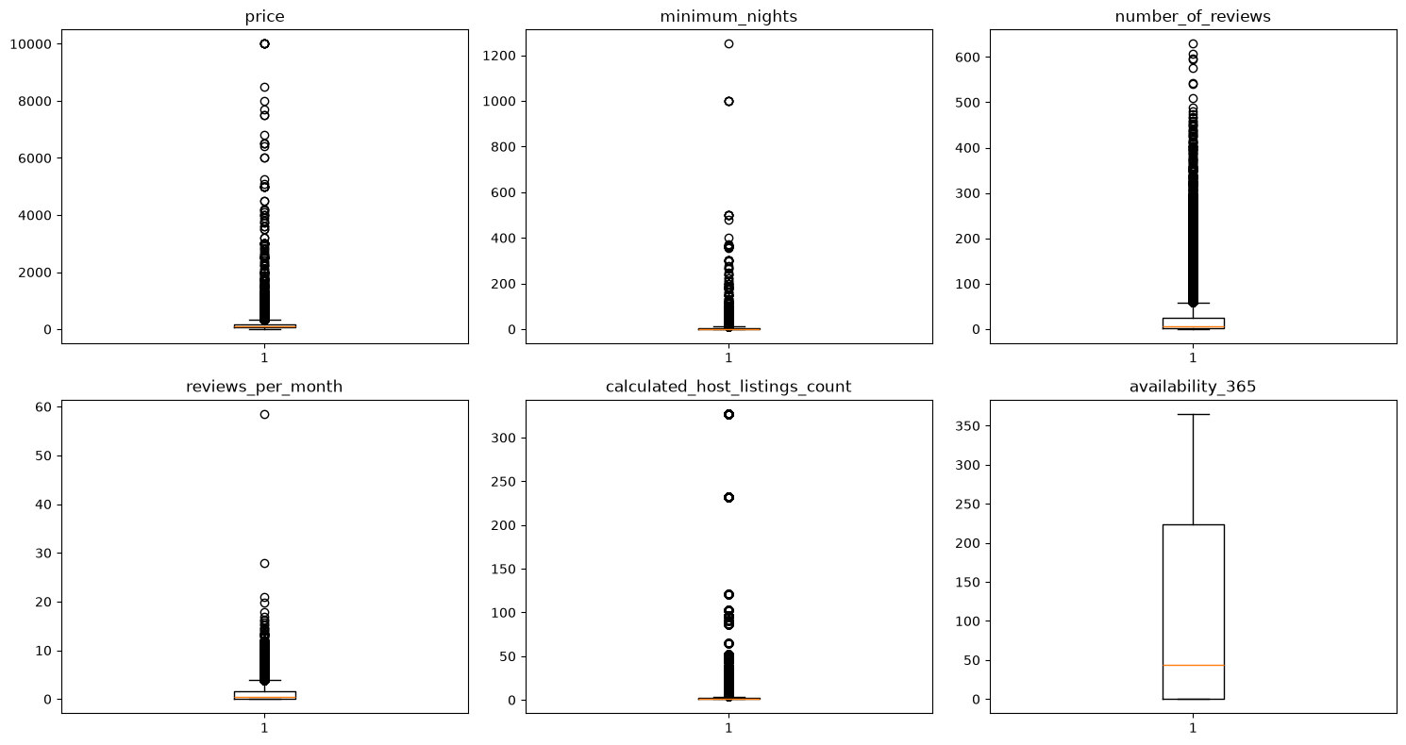
Outliers are real not errors
Box plots and IQR
Flagged by IQR
price
2,936
minimum_nights
6,466
number_of_reviews
6,021
reviews_per_month
3,207
host_listings
6,895
availability_365
0
Kept all. Capped only minimum_nights.
Notes:
Every column except availability is full of outliers. But an outlier is not the same as an error. A ten thousand dollar penthouse is a real listing. A host with 327 properties is a real business. So I kept all of them and capped only minimum nights. That was the one case where the value was logically impossible rather than merely extreme.

Slide 5
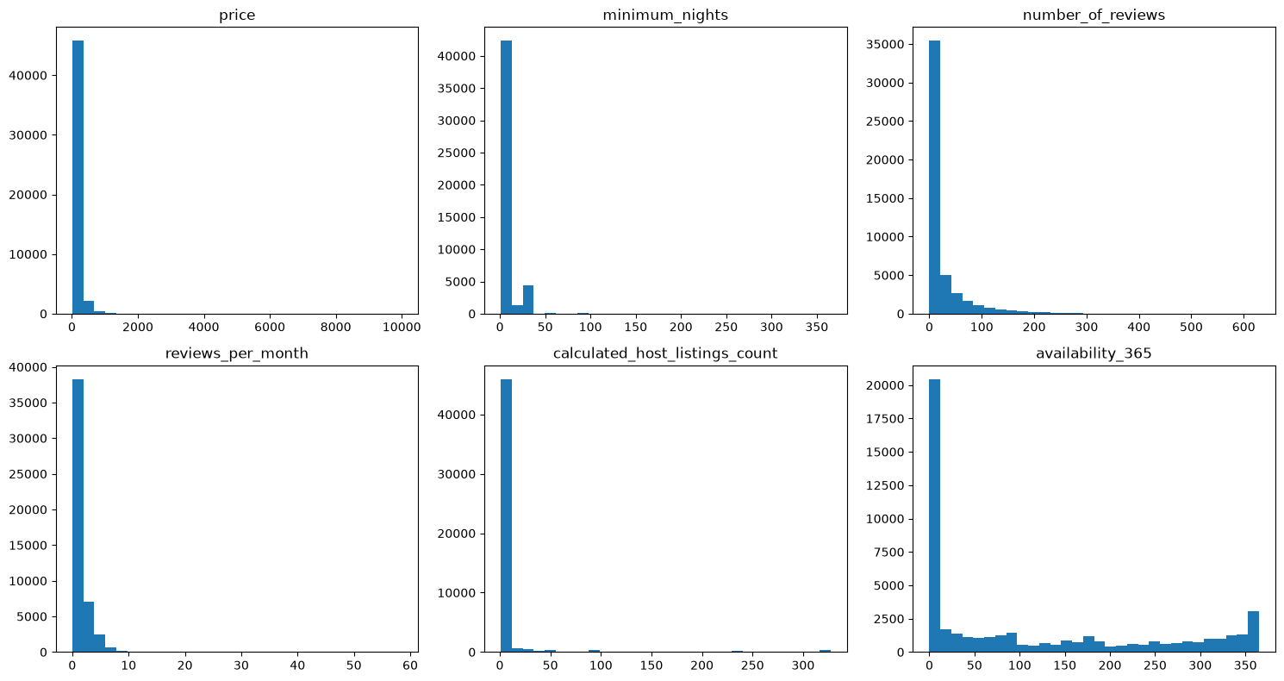
Everything skews right
Mean above median in all six
$152
mean
$105
median is the honest number
Long tail of luxury listings
availability is bimodal
0 days or 365 with nothing between
Notes:
Every distribution leans right. The gap between the mean of 152 and the median of 105 is the whole story. Quoting the average overstates what a normal guest actually pays by nearly fifty dollars. The median is the honest number. Availability is the interesting exception. It is bimodal and clusters at zero days and at 365. Hosts are either fully committed or effectively dormant with very little in between.

Slide 6
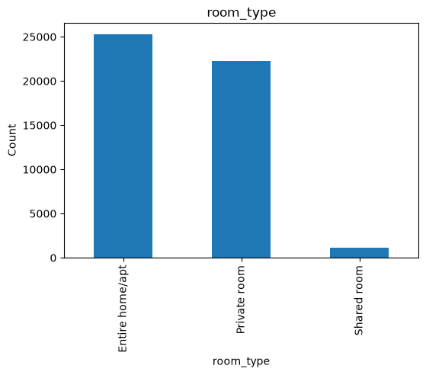
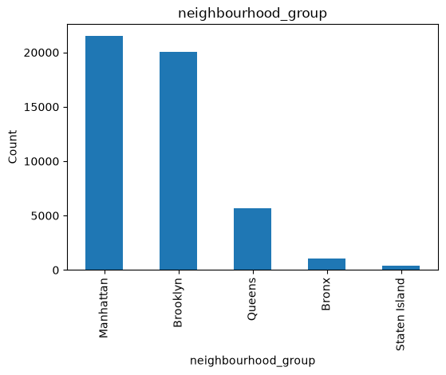
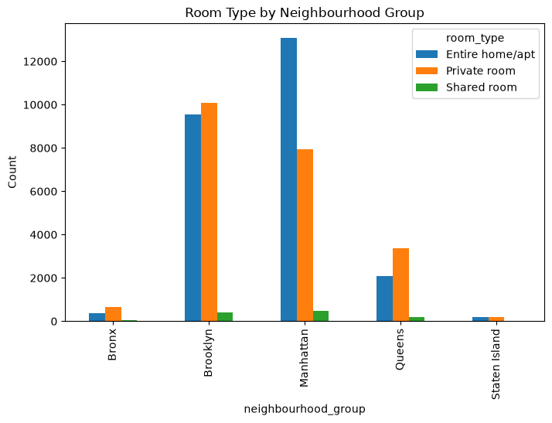
A concentrated market
Two room types and two boroughs
Entire 52% · Private 46% · Shared 2%
Manhattan and Brooklyn are 85%
Room type within each borough
Both columns are badly imbalanced. Minority classes are too small to model.
Notes:
Both categorical columns are imbalanced. Shared rooms are two percent of supply. Manhattan and Brooklyn together are eighty five percent. And they interact. Manhattan skews to entire homes while the outer boroughs skew to private rooms.

Slide 7
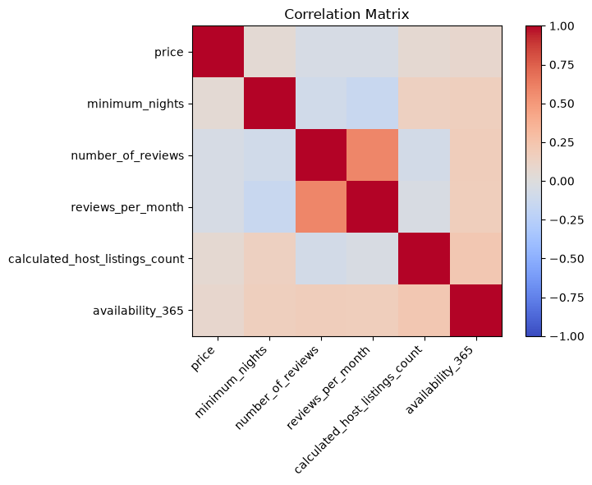
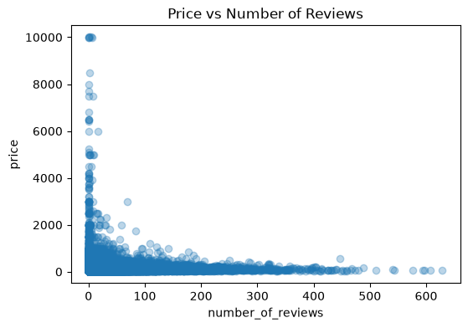
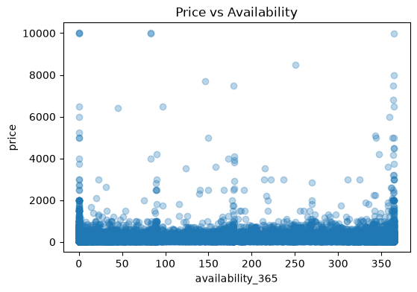
Price ignores the numbers
Every correlation under 0.08
Correlation matrix
Price vs reviews
Price vs availability
Not activity. Location and room type.
Notes:
This was the most interesting finding for me. I expected review volume or availability to move with price. They do not. Every correlation with price is under 0.08 in absolute terms and that is effectively zero. The scatter plots confirm it with no visible structure. Price in this market is simply not explained by how busy a listing is. It is location and room type.

Slide 8
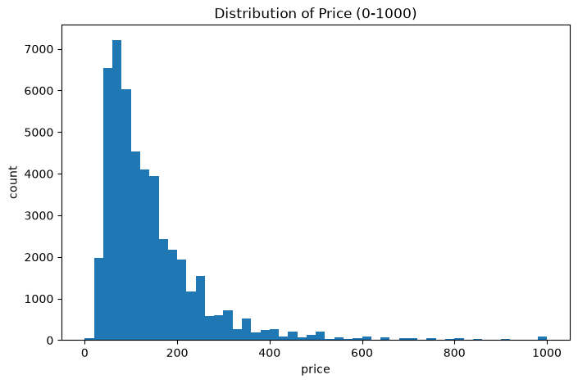
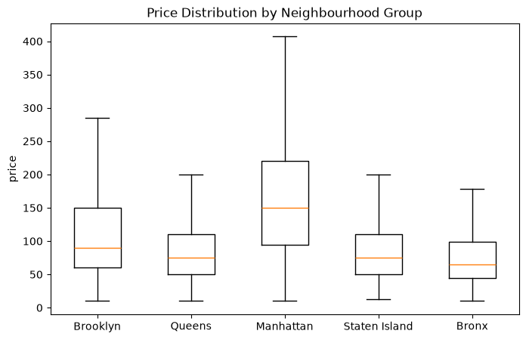
Where the money is
Histogram capped at $1,000
Most listings under $200
Manhattan has the widest spread
Manhattan $196 · Brooklyn $125 · Staten Island $115 · Queens $100 · Bronx $88
Notes:
Price is capped at a thousand on the left. Otherwise a few luxury listings flatten everything. Most of the market sits under two hundred. The right hand chart splits by borough. Manhattan at 196 against the Bronx at 88.

Slide 9
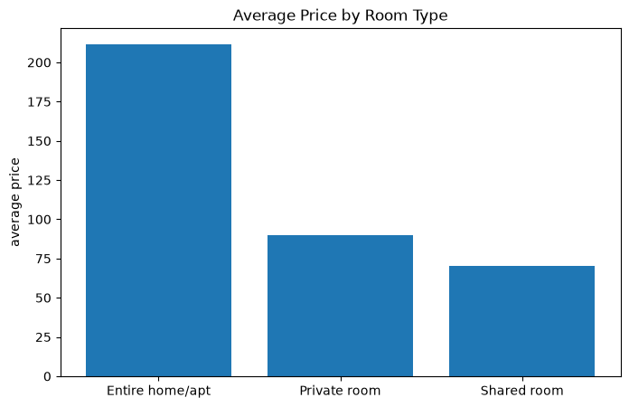
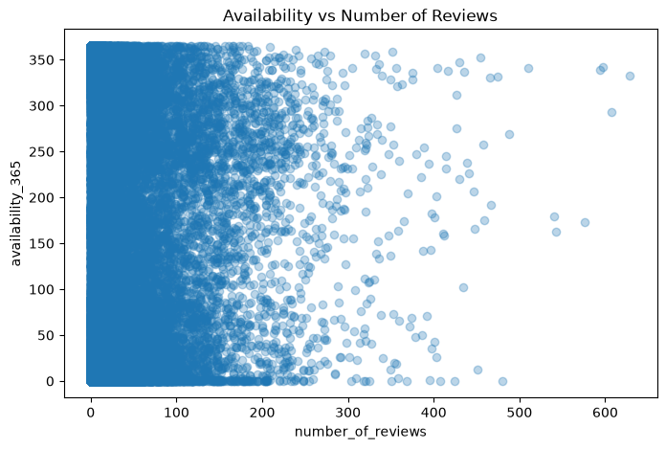
The premium guests pay
Room type is the sharpest divide
Entire $211 · Private $90 · Shared $71
Reviews and availability unrelated
2.4x for not sharing a front door
Notes:
Room type is the sharpest divide in the data. An entire home is 211 and a private room is 90. Two and a half times over for privacy. The right hand chart is a negative result. Reviews and availability are unrelated.

Slide 10
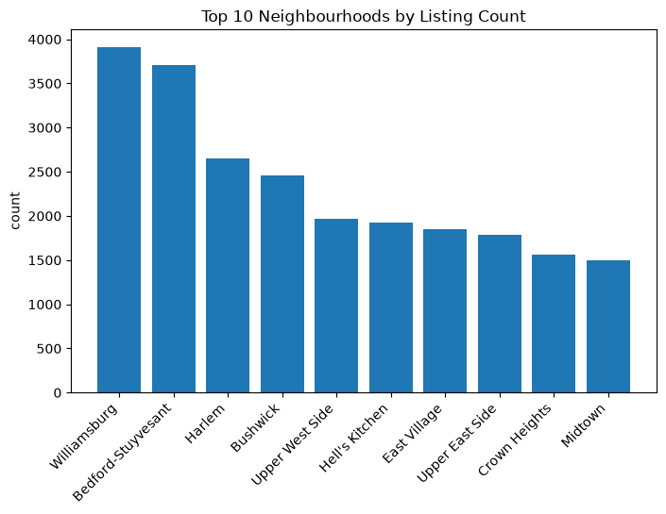
Supply clusters
221 neighbourhoods and 10 dominate
Why it matters
Williamsburg and Bed-Stuy lead
High cardinality with 221 columns if encoded
Most have too few listings to price
Group the tail or fall back to borough
Notes:
There are 221 neighbourhoods but listings pile into a handful. Practically that means high cardinality and imbalance. Most neighbourhoods have too few listings to estimate a price. So you group the tail or fall back to borough.

Slide 11
What the data says
Six of the ten in the notebook
01
02
03
Location beats everything
Privacy is the product
The mean misleads
Manhattan 2x Brooklyn
entire home 2.4x private
$152 against $105 median
04
05
06
Activity is not price
A fifth are invisible
Professionals have arrived
all correlations under 0.08
20.3% never reviewed
Sonder 327 · median host 1
Notes:
Pulling it together. Location and room type set the price and nothing else comes close. The median is the honest number to quote rather than the mean. Activity metrics are not a pricing signal at all. Two structural findings are worth flagging. A fifth of all listings have never been reviewed. And professional operators running hundreds of units now sit alongside the median host who runs exactly one.

Slide 12
What I would do about it
Each one is tied to a finding
1
Price on location and room type
drop the features that predict nothing
2
Badge for new listings
help the 20% with no reviews
3
Ship a real pause button
hosts already fake one
4
Recruit outside the core two
Staten Island and the Bronx
5
Flag duplicates at creation
keep inventory counts honest
Notes:
Five recommendations and each one is traceable to a finding. Pricing guidance drops the useless features. The badge closes the review gap. The pause toggle fixes a behaviour the data caught. Duplicate flagging closes the gap that let 217 through.

Slide 13
WHAT I TOOK AWAY
EDA is the argument
not the output.
Hardest
Best judgement
Next time
defining what counts as the same listing
kept the 1,250-night signal
dedupe before the missing-value audit
Thank you · Khalid Al Dosari
Notes:
Three takeaways. The duplicates were hardest because there was no key. I had to define what counts as the same listing. My best judgement was keeping the impossible minimum nights values. Reading the listing names turned dirt into a finding. Thank you.

